Slide 1
CS 4031 Compiler Construction Chapter 6
Faryal Saud
Lecturer, Department of Computer Science
FAST NUCES CFD

Slide 2
Types of SDT
There is one more type called the L-attribute definition. The difference between S-attributed and L-attributed is as follows:
S-attributed grammar | L-attributed Grammar
It uses only synthesized attributes. Semantic actions can be placed only at the end of the right hand side of a production. Attributes are generally evaluated during bottom-up parsing | It allows both types. But if an inherited attribute is present, there is a restriction. The restriction is that each inherited attribute is restricted to inherit either from parent or from left sibling only. Semantic actions can be placed anywhere on the right hand side. 3. Attributes are generally evaluated by traversing the parse tree depth first and left to right.

Slide 3
L-Attributed Grammar
It allows both types, that is, synthesized as well as inherited. But if at all an inherited attribute is present, there is a restriction.
The restriction is that each inherited attribute is restricted to inherit either from parent or from left sibling only.

Slide 4
Example:
For example, consider the rule
A → XYZPQ
assume that there is an inherited attribute. “i” is present with each nonterminal.
Valid Action of L Attributed Grammar | Invalid Action using L Attributed Grammar
Z•I = f(A•i|X•i|Y•i) | Z•i = f(P•i|Q•i)

Slide 5
Example
Consider the following SDT:
A → LM {L•i = f(A•i);
M•i = f(L•s)
A•s = f(M•s);}
A → QR {R•i = f(A•i);
Q•i = f(R•s)
A•s = f(Q•s);}
Is it L-Attributed or S-Attributed?

Slide 6
Solution:
Look at semantic actions. Here by looking at semantic actions we understand that “s” is synthesized and “i” is inherited. So actions in first rule are correct since “i” is dependent on parent or left siblings only. But look at the second action in A → QR, Q.i = f(R.s); this violates the basic property of L-attributed definition. Inherited attribute can inherit either from

Slide 7
Semantic Analyzer
A semantic analyzer mainly performs static checking. Static checks can be any one of the following type of checks:
Uniqueness checks
Flow of control checks
Type checks
Name-related checks

Slide 8
Uniqueness Check
This ensures uniqueness of variables/objects in situations where it is required.
Example
in most of the languages no identifier can be used for two different definitions in the same scope.

Slide 9
Flow of Control Check
Statements that cause flow of control to leave a construct should have a place to transfer flow of control. If this place is missing, it is confusion.
Example
in C language, “break” causes flow of control to exit from the innermost loop. If it is used without a loop, it confuses where to leave the flow of control

Slide 10
Type Checks
A compiler should report an error if an operator is applied to incompatible operands.
Example
for binary addition, operands are array and a function is incompatible. In a function, the number of arguments should match with the number of formals and the corresponding types.

Slide 11
Name-Related Checks
Sometimes, the same name must appear two or more times.
Example
in ADA, a loop or a block may have a name that appears at the beginning and end of the construct. The compiler must check whether the same name is used at both places.

Slide 12
TYPE CHECKING

Slide 13
Type Checking
A type is a set of values and operations on those values
A language’s type system specifies which operations are valid for a type
The aim of type checking is to ensure that operations are used on the variable/expressions of the correct types

Slide 14
Type System
Languages can be divided into three categories with respect to the type: –
“untyped”
No type checking needs to be done
Assembly languages
Statically typed
All type checking is done at compile time
Also, called strongly typed
Dynamically typed
Type checking is done at run time
Mostly functional languages like Lisp, Scheme etc.

Slide 15
Type System
A type system is a collection of rules for assigning type expressions to various parts of a program
Different type systems may be used by different compilers for the same language
In Pascal type of an array includes the index set. Therefore, a function with an array parameter can only be applied to arrays with that index set
Many Pascal compilers allow index set to be left unspecified when an array is passed as a parameter

Slide 16
Types of Expression
Basic Type
Constructor Type
Product Type
Record Types
Pointer
Function

Slide 17
Basic Type
Basic Type
Boolean
Char
Integer
Real
Void
type_error

Slide 18
Constructor Type
A type constructor applied to type expression is a type expression
Array : array(I , T)
I is used to set the index.
T is used to declare the type of expression.
Example:
var C : array[1…20] of integer
Array(1…20, integer)

Slide 19
Pointer
Pointer (T) is a type expression denoting the type “pointer to an object of type T where T is a type of expression.
Example:
Var ptr : *row
Declares variable “ptr” to have type pointer (row).

Slide 20
Function D →R
a function is a mapping from elements of one set called domain to another set called range. We may treat functions in programming languages as map ping a domain type “Dom” to a range type “Rg.”. The type of such a function will be denoted by the type expression Dom
Example
the built-in function mod, i.e. modulus of Pascal has type expression
int × int → int.
Example:
The type expression of function “fun” is thus denoted as follows:
char × int → int

Slide 21
Example:
Write type expression for a pointer to array of real, where the array index ranges from 1 to 100.
Write a type expression for a function whose domains are from integers to character and whose ranges are pointer to integer.

Slide 22
Solution:
Write type expression for a pointer to array of real, where the array index ranges from 1 to 100.
Solution: The type expression is pointer(array[1…100,real]).

Slide 23
Solution:
Write a type expression for a function whose domains are from integers to character and whose ranges are pointer to integer.
Type expression is
Domain type expression is integer → character
Range type expression is pointer (integer)
The final type expression is (integer → character) → (pointer(integer))

Slide 24
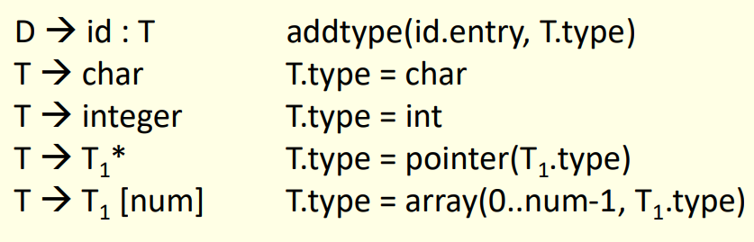
Rules for Symbol Table Entry

Slide 25
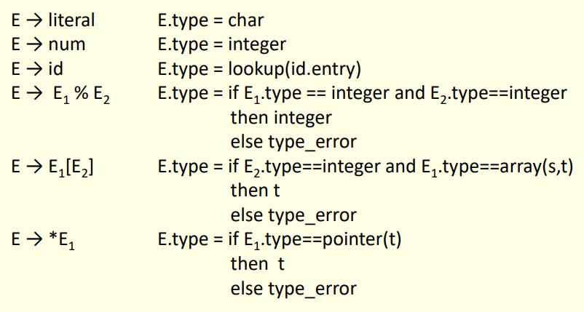
Type Checking for Expression

Slide 26
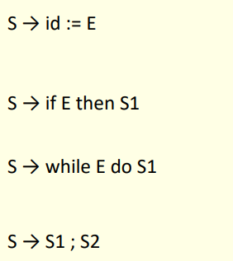
Type Checking for Statement

Slide 27
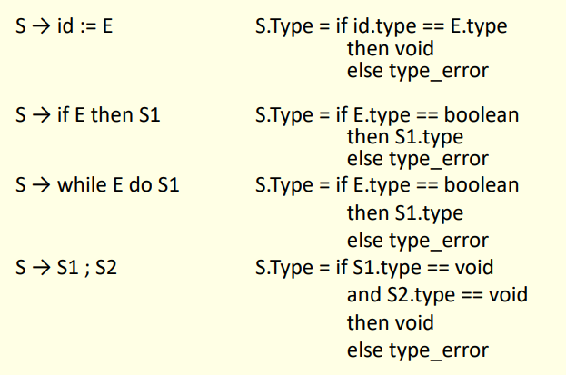
Type Checking for statement
Statements typically do not have values. Special basic type void can be assigned to them.

